Slide 1

Business Registration
How to Submit a New Registration Application

Slide 2
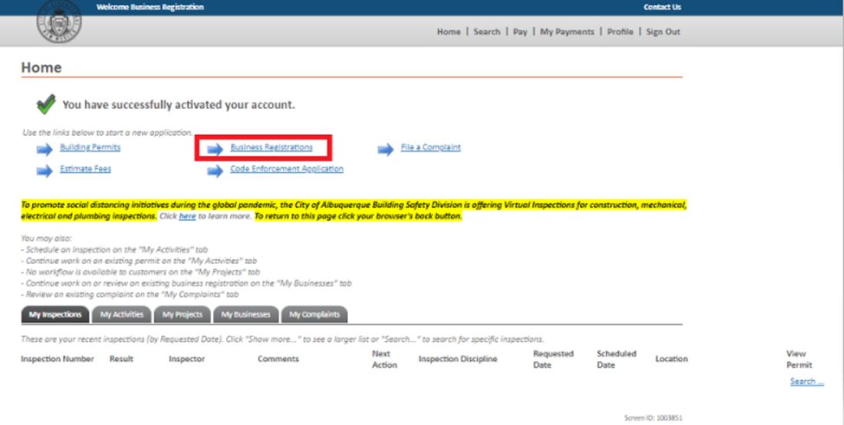

Slide 3
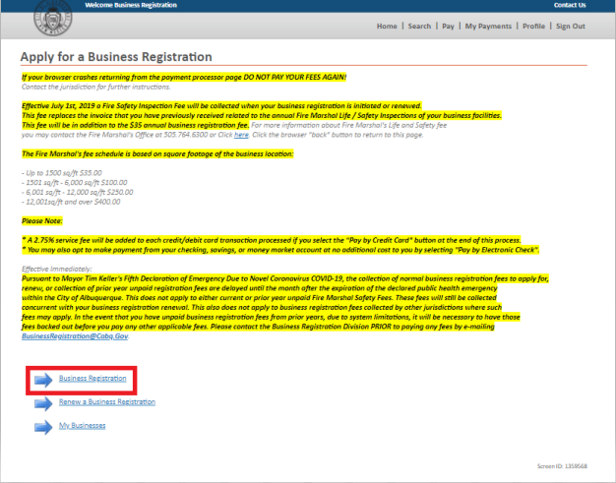

Slide 4
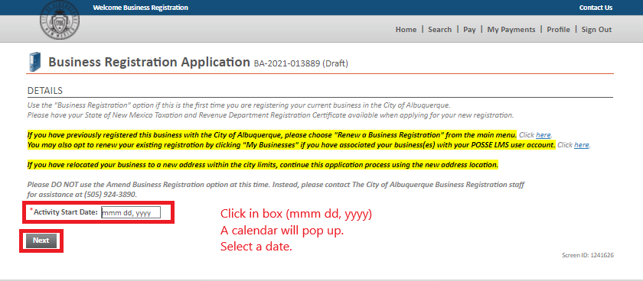

Slide 5
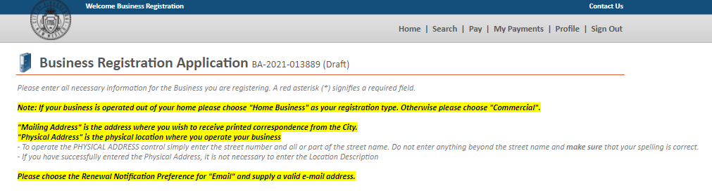

Slide 6
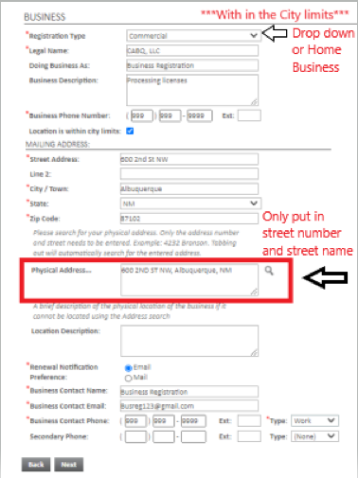
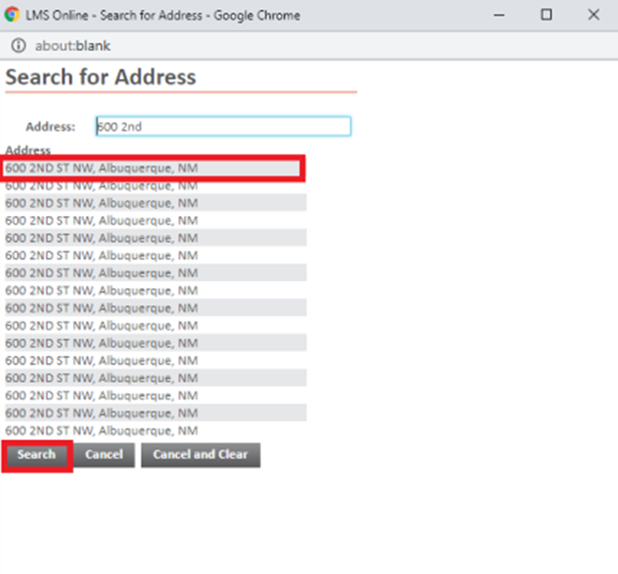
Legal Name and Doing Business As:
If Sole Proprietor- Owners Name Doing Business As: Business Name
If Corp./LLC- Business Name Doing Business As: Business Name
Add a Business Description

Slide 7
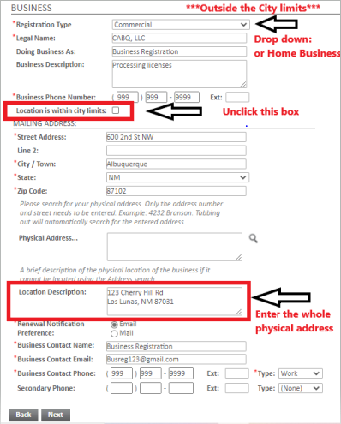


Slide 8
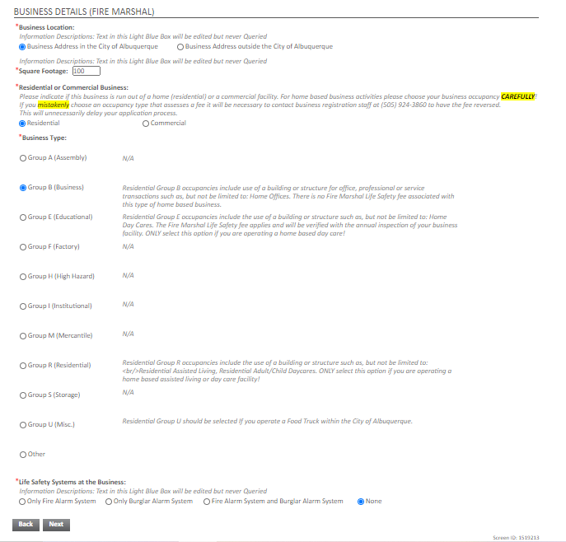
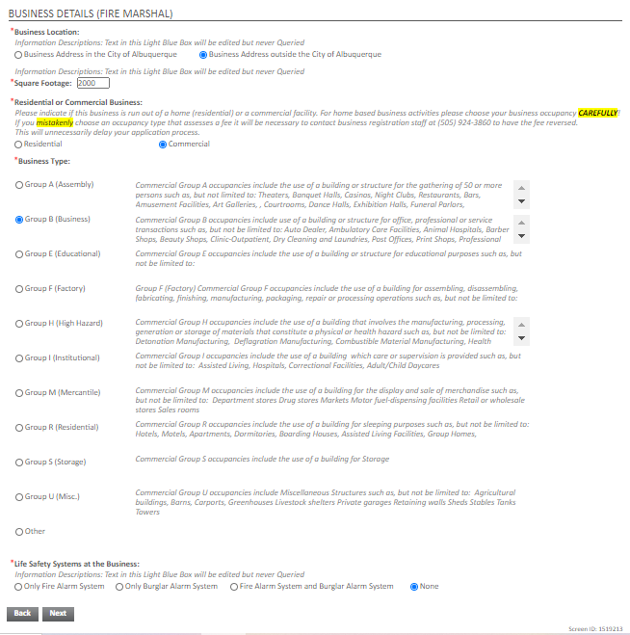
***Within the City limits***
***Outside the City limits***

Slide 9
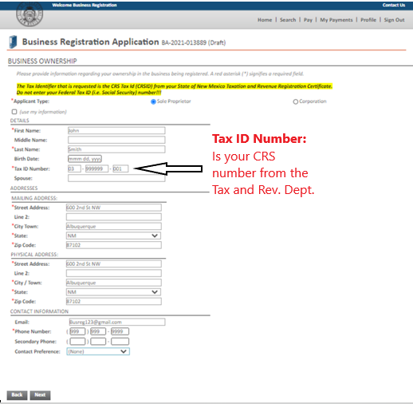
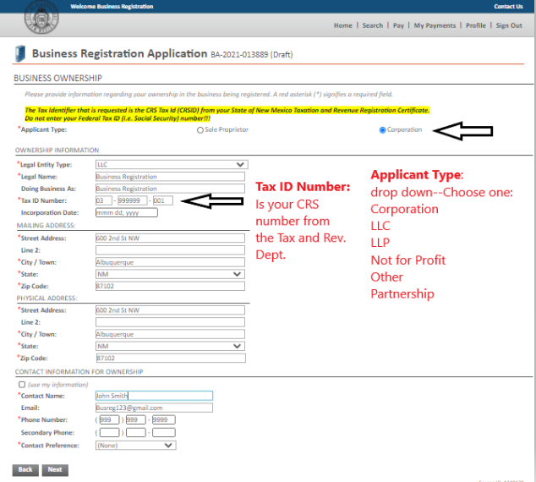
Sole Proprietor
Incorporated

Slide 10
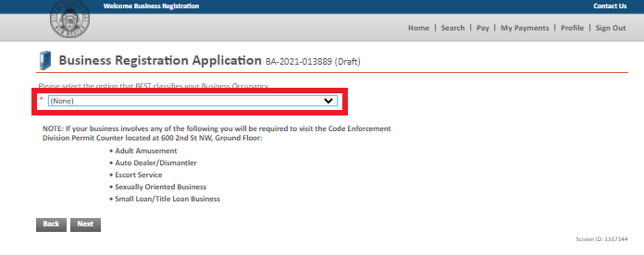
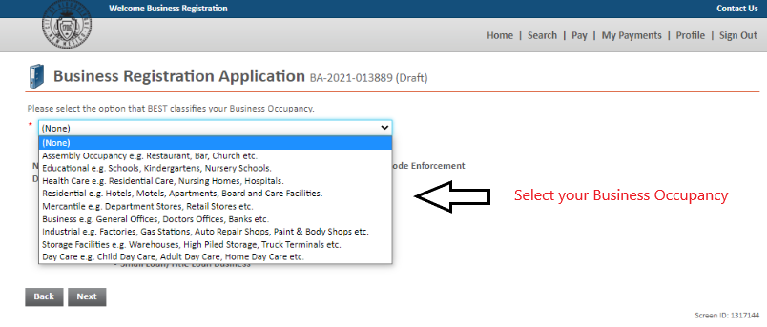

Slide 11
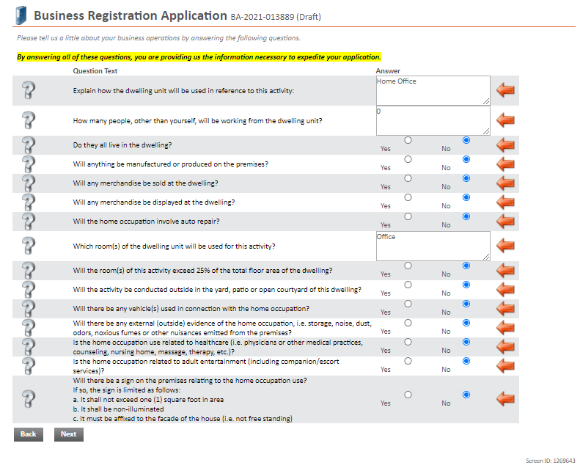
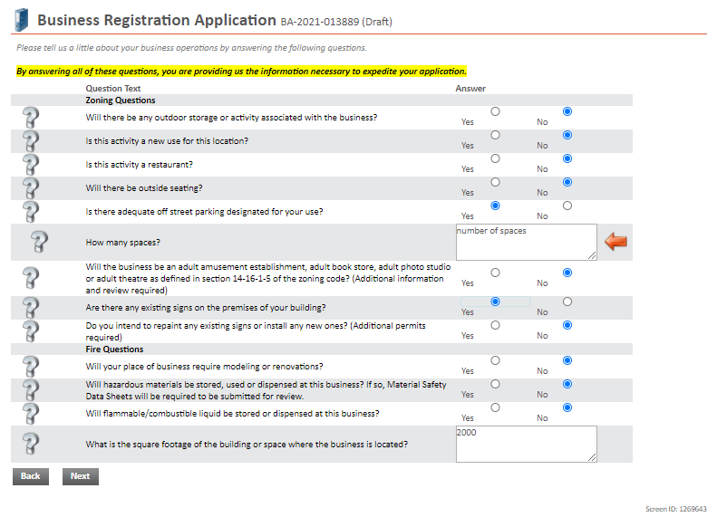
Home Business
Commercial

Slide 12
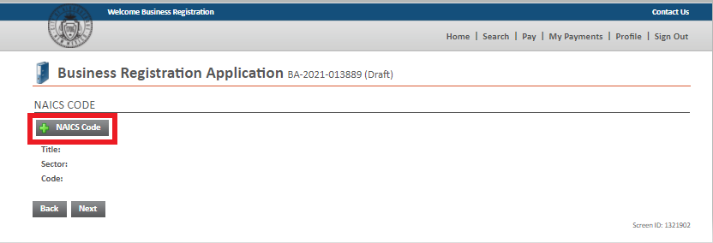
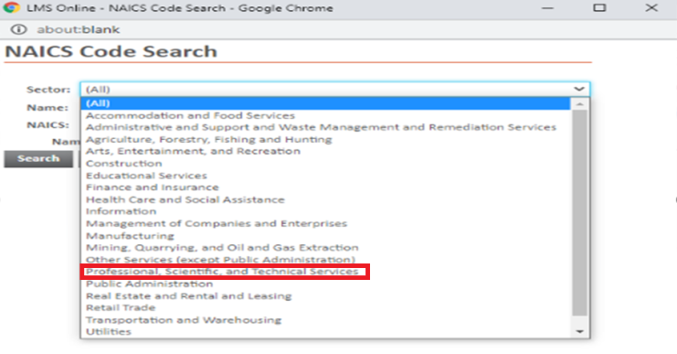
***Please select the best fit for your company***

Slide 13
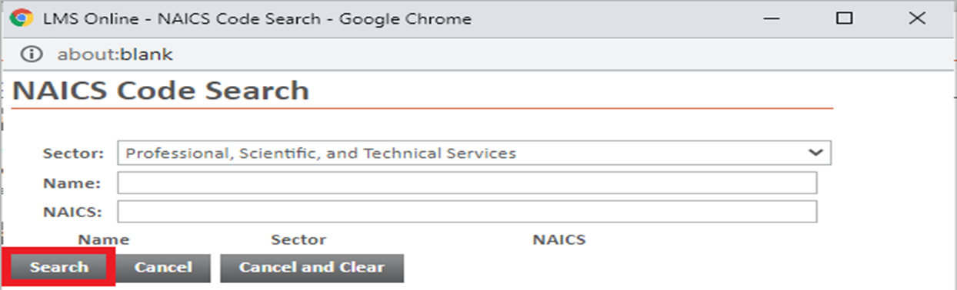
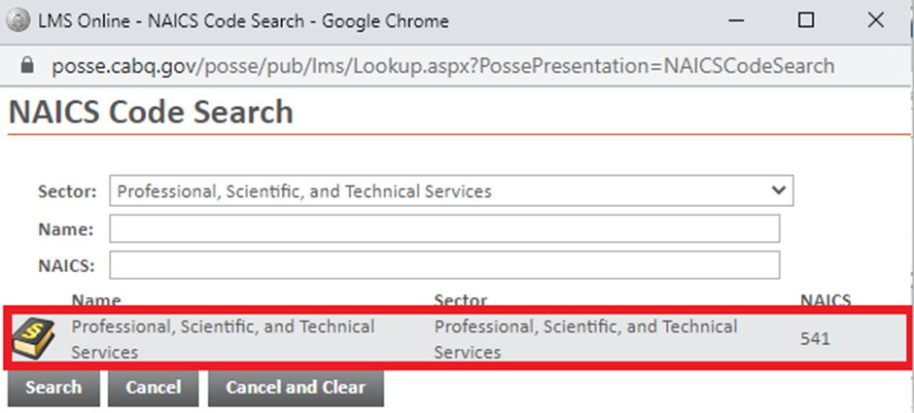
Leave these two boxes blank

Slide 14
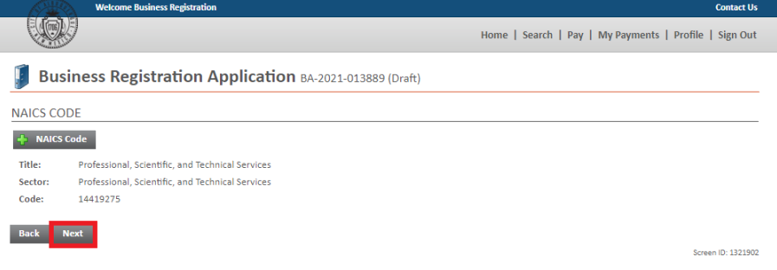

Slide 15
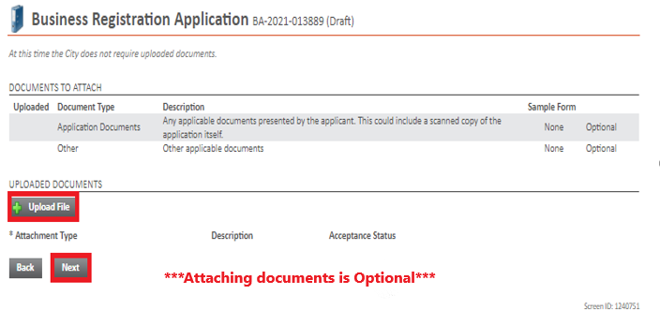

Slide 16
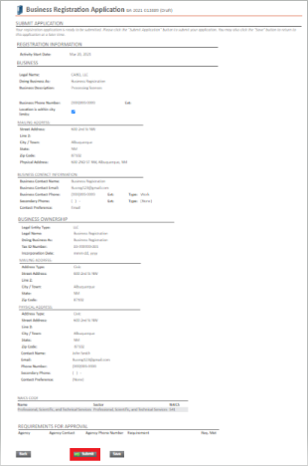
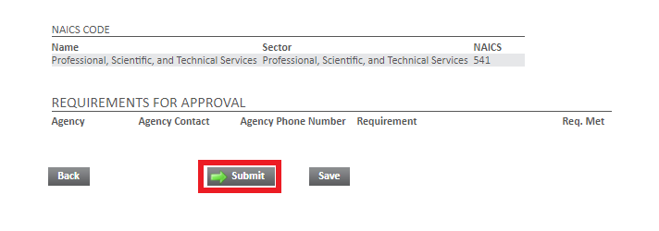
*** Verify your information before you submit your application***

Slide 17
Your application is submitted, it is currently being reviewed by the Zoning Department. This process can take up to 10 business days.
If you have any questions or concerns regarding your application, please contact Business Registration at 505-924-3890 or email us at businessregistration@cabq.gov.

